Slide 1
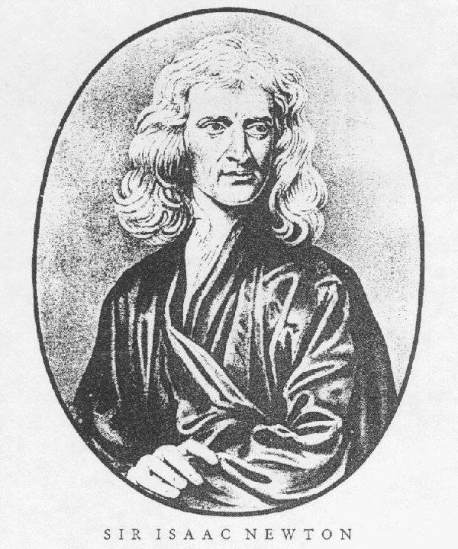
Applying Newton’s Laws
1642 – 1727
Developed three Laws of Motion
“Invented” Calculus

Slide 2
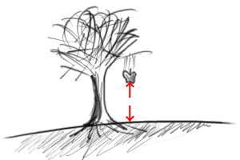
Newton’s Laws of Motion
An object at rest will remain at rest, an object in motion remain in motion with a constant velocity unless acted on by a net external force.

Slide 3
Newton’s Laws of Motion
The acceleration of a body is proportional to the net force on the body AND proportional to the inverse of the body’s mass.
ΣF = ma

Slide 4
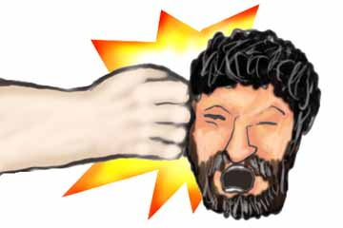
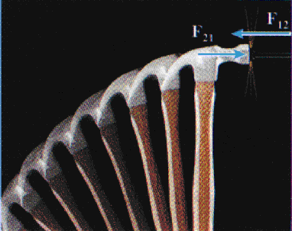
Newton’s Laws of Motion
For every force there is an equal but opposite force
F_{head on hand}
= F_{hand on head}

Slide 5
Everyday Forces
Weight: This is the force of gravity. Or gravity acting on a mass.
One of the few non-contact forces!
Fg = mg (W = mg)
2. Normal Force, F_{N}: The force a surface applies to an object. It is always perpendicular to surface

Slide 6
Everyday Forces
Tension, F_{T}: The force applied by a rope. Or the force in a rope. Ropes only pull. The rope acts on the object, not the person or machine
Friction, F_{k} or F_{s}: The force a surface applies that resists motion or an applied force. Always parallel to the surface opposite motion or potential motion

Slide 7
Everyday Forces
Applied Force: A force applied by some object, like a person, that does not fall into any previous category. In the direction specified.
  Note: Applied forces cannot act unless it is TOUCHING another object.
  Question: How many forces are on a ball AFTER you've thrown it?
TWO if you count air friction

Slide 8
Types of Friction
Kinetic Friction: this is moving friction
Static Friction: this is non-moving friction
Both friction types are defined by the coefficient of friction, μ (pronounced mu)
Coefficient of kinetic Friction: μ_{k}
Coefficient of static Friction: μ_{s}

Slide 9
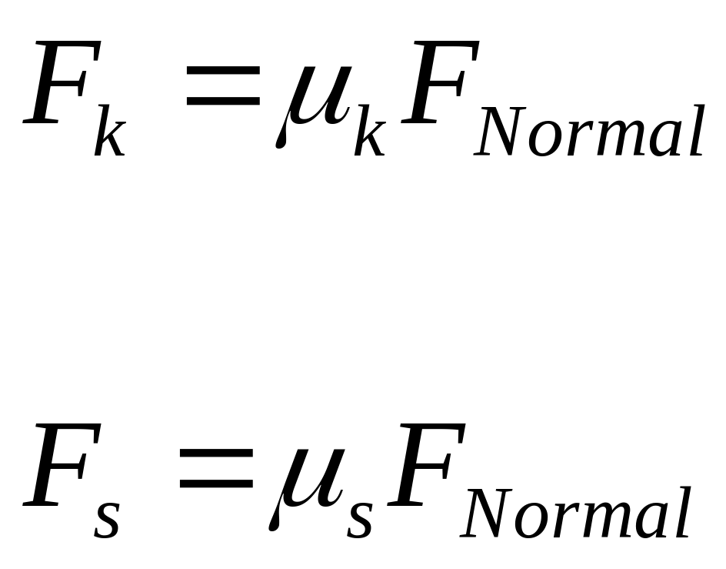
Friction Equations
Note: Most questions deal with kinetic friction

Slide 10
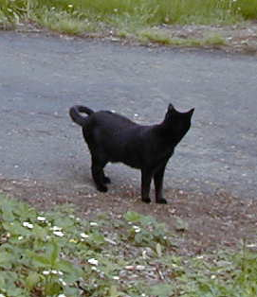
Drawing Free Body Diagrams
Draw forces acting on object acting through the center of mass (ask the 5 questions on the next slide)
Label “everyday” Forces
Label acceleration if present
Apply ΣF=ma in x and y directions
Use 5 kinematics equations to solve for other unknowns
F_{N}
a = 0
Fg

Slide 11
5 Questions to ask when drawing an FBD
Is it on Earth?
    If yes, then there is weight and it is straight down
Is it on a surface?
    If yes, then there is a normal force and it is perpendicular to the surface
Is there a rope involved?
    If yes, then there is tension and it acts along the rope
Is it on a rough surface?
    If yes, then there is friction and it is parallel to the surface opposite the motion or intended motion
    Assume no air friction unless stated otherwise
Is someone pushing or pulling the object?
    If yes, then there is an applied force and it is in the direction indicated

Slide 12
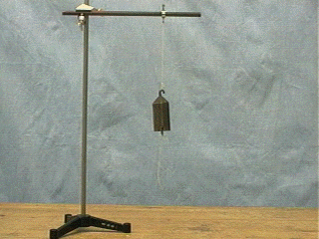
Draw a Free Body Diagram of the Mass

Slide 13
F_{T}
F_{rod?}
a = 0
The Rod is not touching the mass
Fg

Slide 14
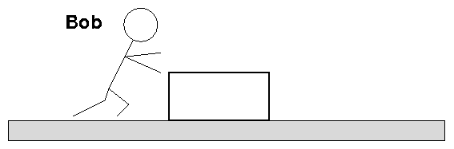
Draw a FBD of a box being pushed by Bob

Slide 15
Free body diagram
F_{N}
F_{applied}
Ff (motion)
Fg

Slide 16
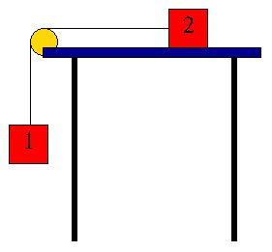
Draw the FBD for the 2 Masses

Slide 17
F_{N}
F_{T}
F_{f}
F_{T}
F_{g2}
The FT on both boxes are the same
F_{g1}

Slide 18
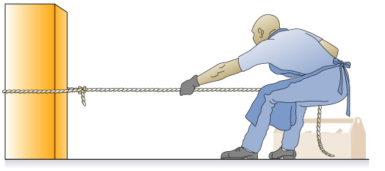
System Diagram
What happens if the rope gets cut?
a = 0

Slide 19
Free Body Diagrams
What happens if the rope gets cut?
F_{N}
F_{N}
F_{f(s)}
F_{T}
F_{f(s)}
F_{T}
a = 0
F_{g}
F_{g}

Slide 20
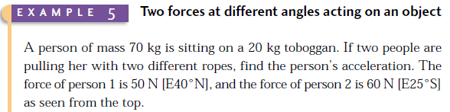
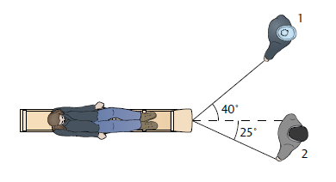
Page 133, Example 5

Slide 21
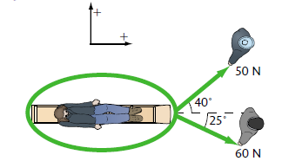
Free Body Diagram

Slide 22

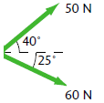
REAL Free body
m = 70 kg + 20 kg
=90 kg

Slide 23
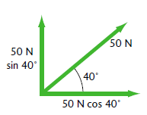
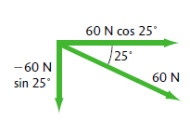
Component Time!
m =90 kg

Slide 24
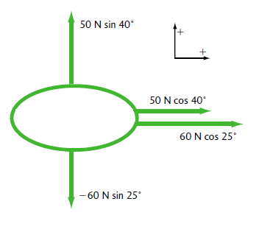
x & y directions only
m = 90 kg

Slide 25




Net Forces + 2nd law
Fnet

