Slide 1
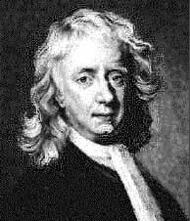
Newton’s Laws Of Motion
What is a Force?
Notes:
A Force is a PUSH or a PULL

Slide 2
Newton’s 1st and 2nd Laws of Motion
1st Law
  An object at rest will stay at rest and an object in uniform motion will stay in uniform motion unless acted upon by an unbalanced force.
        What is the meaning of an unbalanced force?
2nd Law
  The acceleration of an object as produced by a net force is directly proportional to the magnitude of the net force, in the same direction as the net force, and inversely proportional to the mass of the object.
      What is the mathematical formula for this long paragraph?
Notes:
Unbalaced force = non zero total force
a = Fnet/m

Slide 3
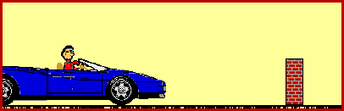
When Do We See These Laws Into Action?
The 1st and 2nd law are put into action everyday!
What happens to the person when the car hits the brick wall?
  According to the 1st law, why does this happen?
What modern day technologies or safety features have been created to limit the effects of automobile accidents?
  How do these technologies apply to Newton’s 2nd law?
Notes:
-The person continues to accelerate once the car hits the brick wall because the person did not hit the brick wall itself. As the car accelerates, the person does also.
-The 1st law says that the person will stay in motion until it is acted on by an unbalanced force, which would have been the brick wall if the person would have hit it. The person continues to move until it hits something.
-Air bags and crumple zones are some examples of safety features that have been created to limit the effects of auto accidents.
-These technologies were designed to lower the acceleration of the person involved to limit the effects of damage done by an auto accident.

Slide 4
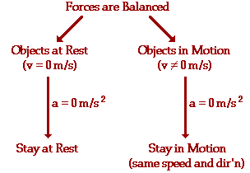
Newton’s 1st Law Explained
Predicts the behavior of stationary objects
Predicts the behavior of objects in motion
Notes:
-An object at rest will stay at rest and an object at motion will stay in motion unless an unbalanced force acts upon that object.
-This diagram shows the velocity and acceleration for an object at rest and an object in motion.
-The animation shows that the car and the person are both accelerating, when it hits the brick wall the person inside the car will stay in motion until he/she is acted upon by an unbalanced force.

Slide 5
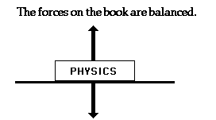
Newton’s 1st Law Explained
Balanced Force
Objects will keep “doing what they’re doing” until they are acted upon by unbalanced force.
A Balanced Object
  Consider a Physics book at rest on a table top.
Notes:
-The force of gravity is pulling downward on the book and the table is pushing up on the book.
-These forces are of equal magnitude and in the opposite direction of each other, so the book stays at rest.

Slide 6

Newton’s 1st Law Explained
“Law of Inertia”
Newton’s 1st Law = Law of Inertia
Inertia = the resistance an object has to a change in its state of motion.
Newton & Galileo
  A force is NOT required to keep a moving object in motion, it is a force which brings a moving object to rest.
What if there were no friction?
Notes:
Newton and Galileo had a real reputation for bucking the system!
-In their time, the thought was that all objects had a desire to be at rest. A moving object required a push/force to keep it moving.
-Galileo proposed and Newton proved the opposite: An object will stay in motion until a force causes it to come to rest!
-What is this force? FRICTION
-If there were no friction, then moving objects would continue to move forever!

Slide 7
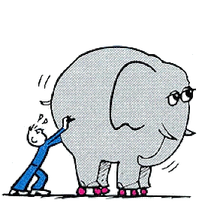
Newton’s 1st Law Explained
“Law of Inertia”
All objects have inertia
Do some objects have more of a tendency to resist changes than others?
The inertia of an object depends upon the object’s mass.
  More mass = more inertia
  (Bricks)
Notes:
Yes! More massive objects have more of a resistance to change.
-How could you tell the mass of 2 bricks that look the same without picking them up?
-Apply the same amount of force (push) to them both. The more massive brick will be more resistant to move.

