Slide 1
Mechanics
Topic 2.2 Forces and Dynamics
Continued…

Slide 2
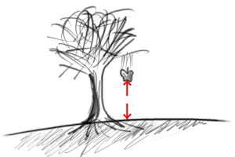
Newton´s Laws
The First Law
Every object continues in a state of rest or uniform motion in a straight line unless acted upon by an external force

Slide 3
Newton´s Second Law
1st version
The acceleration of a body is proportional to the resultant force and occurs in the direction of the force.
ΣF = ma

Slide 4
Newton´s Laws
The Third Law
When two bodies A and B interact, the force that A exerts on B is equal and opposite to the force that B exerts on A.
FAB = - FBA

Slide 5
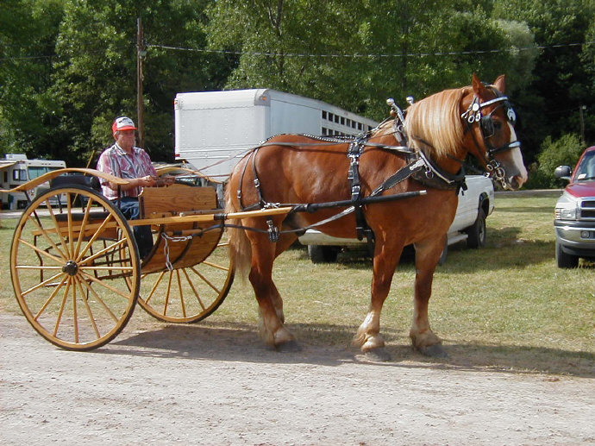
Newton´s 3rd Law
How does the horse pull the cart?

Slide 6
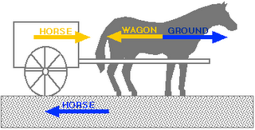
Newton´s 3rd Law
How does the horse pull the cart?

Slide 7
Newton´s 3rd Law
The cart must have a net force forward to move
The horse must overcome the force that the cart exerts on it to move

Slide 8
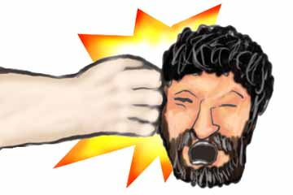
Important
The equal and opposite forces do not act on the same body!
F_{head on hand}
= F_{hand on head}

Slide 9
Everyday Forces
Weight: This is the force of gravity. Or gravity acting on a mass.
One of the few non-contact forces!
Fg = mg (W = mg)
2. Normal Force, F_{N}: The force a surface applies to an object. It is always perpendicular to surface

Slide 10
Everyday Forces
Tension, F_{T}: The force applied by a rope. Or the force in a rope. Ropes only pull. The rope acts on the object, not the person or machine
Friction, F_{k} or F_{s}: The force a surface applies that resists motion or an applied force. Always parallel to the surface opposite motion or potential motion

Slide 11
Everyday Forces
Applied Force: A force applied by some object, like a person, that does not fall into any previous category. In the direction specified.
  Note: Applied forces cannot act unless it is TOUCHING another object.
  Question: How many forces are on a ball AFTER you've thrown it?
TWO if you count air friction

Slide 12
Springs – Hooke’s Law
The extension of a spring which obeys Hooke´s law is directly proportional to the extending tension
F = kx
k is the tension required to produce unit extension (called the spring constant and measured in Nm⁻¹)
x is the extension of the spring from its naturual position

Slide 13
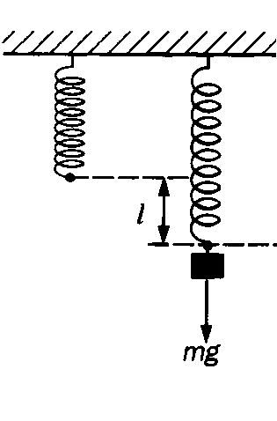
Spring Diagram
For the spring:
Fnet = Fs - Fg
If the mass is motionless, Fnet = 0
Fs = Fg
Substituting Hooke’s Law and Gravity:
kx = mg
x

Slide 14
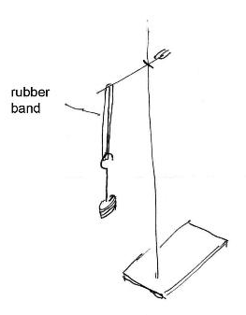
Lab: Spring constant
We will use rubber bands instead of springs
Independent Variable:
  Weight
Dependent Variable:
  Stretch
Controlled Variable:
  Rubber band

Slide 15
Lab: Spring Constant
measure the force applied to a spring (elastic band) and its extension
plot a graph and use the gradient to calculate the spring constant of the spring (elastic band).
Submit via turnitin for DCP

