Slide 1
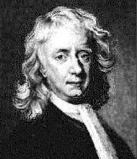
Newton’s Laws Of Motion
What is a Force?

Slide 2

Newton’s 1st law
Newton’s first law was actually discovered by Galileo.
Newton stole it!

Slide 3
Newton’s first law
Galileo imagined a marble rolling in a very smooth (i.e. no friction) bowl.

Slide 4
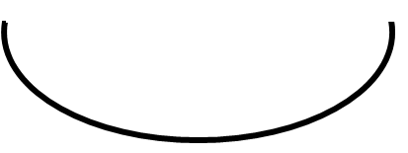
Newton’s first law
If you let go of the ball, it always rolls up the opposite side until it reaches its original height (this actually comes from the conservation of energy).

Slide 5
Newton’s first law
No matter how long the bowl, this always happens

Slide 6
Newton’s first law
No matter how long the bowl, this always happens.
constant velocity

Slide 7
Newton’s first law
Galileo imagined an infinitely long bowl where the ball never reaches the other side!

Slide 8
Newton’s first law
The ball travels with constant velocity until its reaches the other side (which it never does!).
Galileo realised that this was the natural state of objects when no (resultant ) forces act.
constant velocity

Slide 9
Newton’s 1st and 2nd Laws of Motion
1st Law
  An object at rest will stay at rest and an object in uniform motion will stay in uniform motion unless acted upon by an unbalanced force.
        What is the meaning of an unbalanced force?
2nd Law
  The acceleration of an object as produced by a net force is directly proportional to the magnitude of the net force, in the same direction as the net force, and inversely proportional to the mass of the object.
      What is the mathematical formula for this long paragraph?
Notes:
Unbalaced force = non zero total force
a = Fnet/m

Slide 10
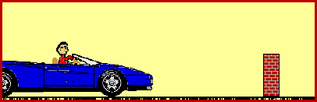
When Do We See These Laws Into Action?
The 1st and 2nd law are put into action everyday!
What happens to the person when the car hits the brick wall?
  According to the 1st law, why does this happen?
What modern day technologies or safety features have been created to limit the effects of automobile accidents?
  How do these technologies apply to Newton’s 2nd law?
Notes:
-The person continues to accelerate once the car hits the brick wall because the person did not hit the brick wall itself. As the car accelerates, the person does also.
-The 1st law says that the person will stay in motion until it is acted on by an unbalanced force, which would have been the brick wall if the person would have hit it. The person continues to move until it hits something.
-Air bags and crumple zones are some examples of safety features that have been created to limit the effects of auto accidents.
-These technologies were designed to lower the acceleration of the person involved to limit the effects of damage done by an auto accident.

Slide 11
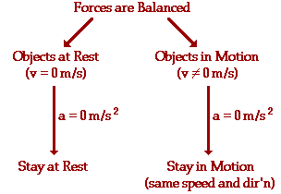
Newton’s 1st Law Explained
Predicts the behavior of stationary objects
Predicts the behavior of objects in motion
Notes:
-An object at rest will stay at rest and an object at motion will stay in motion unless an unbalanced force acts upon that object.
-This diagram shows the velocity and acceleration for an object at rest and an object in motion.
-The animation shows that the car and the person are both accelerating, when it hits the brick wall the person inside the car will stay in motion until hes-1he is acted upon by an unbalanced force.

Slide 12
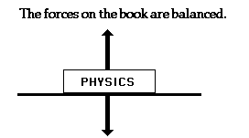
Newton’s 1st Law Explained
Balanced Force
Objects will keep “doing what they’re doing” until they are acted upon by unbalanced force.
A Balanced Object
  Consider a Physics book at rest on a table top.
Notes:
-The force of gravity is pulling downward on the book and the table is pushing up on the book.
-These forces are of equal magnitude and in the opposite direction of each other, so the book stays at rest.

Slide 13
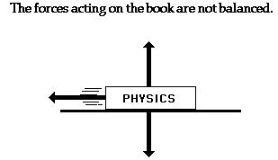
Newton’s 1st Law Explained Unbalanced Force
An Unbalanced Object
  Consider the Physics textbook with an unbalanced force acting upon it.
What caused it to move?
Which force is unbalanced?
NOT at equilibrium = acceleration
Notes:
-Someone has either pushed the book or it could be sliding down an incline. What happened doesn't really matter, but what does matter is the book is in motion.
-Again, the force of gravity is pulling down on the book and the table is pushing up on the book. These two forces are balanced.
-The leftward force of friction is the unbalanced force on acting on the book.
-Friction will cause the book to eventually come to rest.
-Newton stated that if an object has an unbalanced force acting upon it, then it is accelerating.
-According to Newton, an object will only accelerate if there is a net or unbalanced force acting upon it. The presence of an unbalanced force will accelerate an object – changing its speed, its direction, or both its speed and direction.

Slide 14
Determining “Balanced” or “Unbalanced” Forces
Which forces are acting upon the object and in what direction?
  Two individual forces are of equal magnitude and opposite in direction = balanced.
  An individual force acting on the object which is not of equal magnitude OR not in the opposite direction of another force = unbalanced.

Slide 15

Newton’s 1st Law Explained
“Law of Inertia”
Newton’s 1st Law = Law of Inertia
Inertia = the resistance an object has to a change in its state of motion.
Newton & Galileo
  A force is NOT required to keep a moving object in motion, it is a force which brings a moving object to rest.
What if there were no friction?
Notes:
Newton and Galileo had a real reputation for bucking the system!
-In their time, the thought was that all objects had a desire to be at rest. A moving object required a push/force to keep it moving.
-Galileo proposed and Newton proved the opposite: An object will stay in motion until a force causes it to come to rest!
-What is this force? FRICTION
-If there were no friction, then moving objects would continue to move forever!

Slide 16
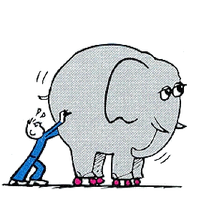
Newton’s 1st Law Explained
“Law of Inertia”
All objects have inertia
Do some objects have more of a tendency to resist changes than others?
The inertia of an object depends upon the object’s mass.
  More mass = more inertia
  (Bricks)
Notes:
Yes! More massive objects have more of a resistance to change.
-How could you tell the mass of 2 bricks that look the same without picking them up?
-Apply the same amount of force (push) to them both. The more massive brick will be more resistant to move.

Slide 17
Check For Understanding
If the forces acting upon an object are balanced, then the object:
  A. must not be moving.
  B. must be moving with a constant velocity.
  C. must not be accelerating.
  D. none of the above.
If you were in a weightless environment in space, would it require a force to set an object in motion?
Answer: C
Answer: Yes! Objects in space still have mass. If an object has mass it has inertia. It will require an applied force to set an object at rest into motion.

Slide 18
Newton’s 2nd Law Explained
Acceleration: depends on 2 variables.
  Net force acting on the object
  Mass of the object
How do these 2 variables effect acceleration?
Forces are Unbalanced
There is an Acceleration
The Acceleration depends directly upon the “net force.”
The Acceleration depends inversely upon the object’s mass.
Notes:
The acceleration of an object depends directly upon the net force acting upon the object, and inversely upon the mass of the object. As the net force increases, so will the object's acceleration. However, as the mass of the object increases, its acceleration will decrease.

Slide 19
Newton’s 2nd Law Explained
“Emphasis on Net Force”
The acceleration is directly proportional to the "net force."
The "net force" equals mass times acceleration.
The acceleration is in the same direction as the "net force."
An acceleration is produced by a "net force."
Units for Force
1 N = 1 kg * ms⁻²
F_{net} = ma
Notes:
If all the individual forces acting upon an object are known, then the net force can be determined.

Slide 20
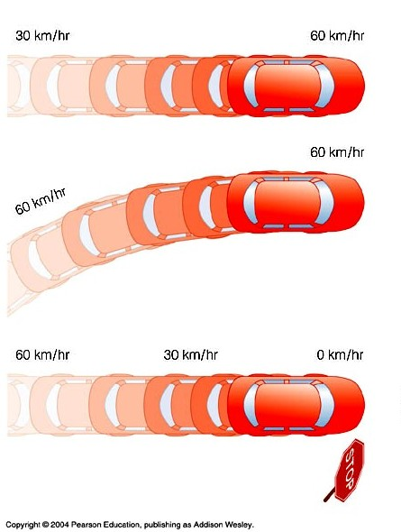
Acceleration
Notes:
First car is accelerating because its velocity is increasing.
Second car is accelerating because its direction is changing.
Third car is accelerating because its velocity and direction are changing.

Slide 21
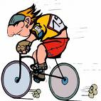
An example
What will be Mr. Peterson’s acceleration?
Mass of Mr Peterson and bike = 100 kg
Pushing force (100 N)
Friction (60 N)

Slide 22
An example
Resultant force = 100 – 60 = 40 N
F_{R} = ma
40 = 100a
a = 0.4 ms⁻²
Mass of Mr Porter and bike = 100 kg
Pushing force (100 N)
Friction (60 N)

Slide 23
Check Your Understanding
1. What acceleration will result when a 12 N net force applied to a 3 kg object?
4 ms⁻²
2. A net force of 16 N causes a mass to accelerate at a rate of 5 ms⁻². Determine the mass.
3.2 kg
3. How much force is needed to accelerate a 66 kg skier 1 ms⁻²?
66 kg-ms⁻² or 66 N
4. What is the force on a 1000 kg elevator that is falling freely at 9.8 ms⁻²?
9800 kg-ms⁻² or 9800 N

Slide 24
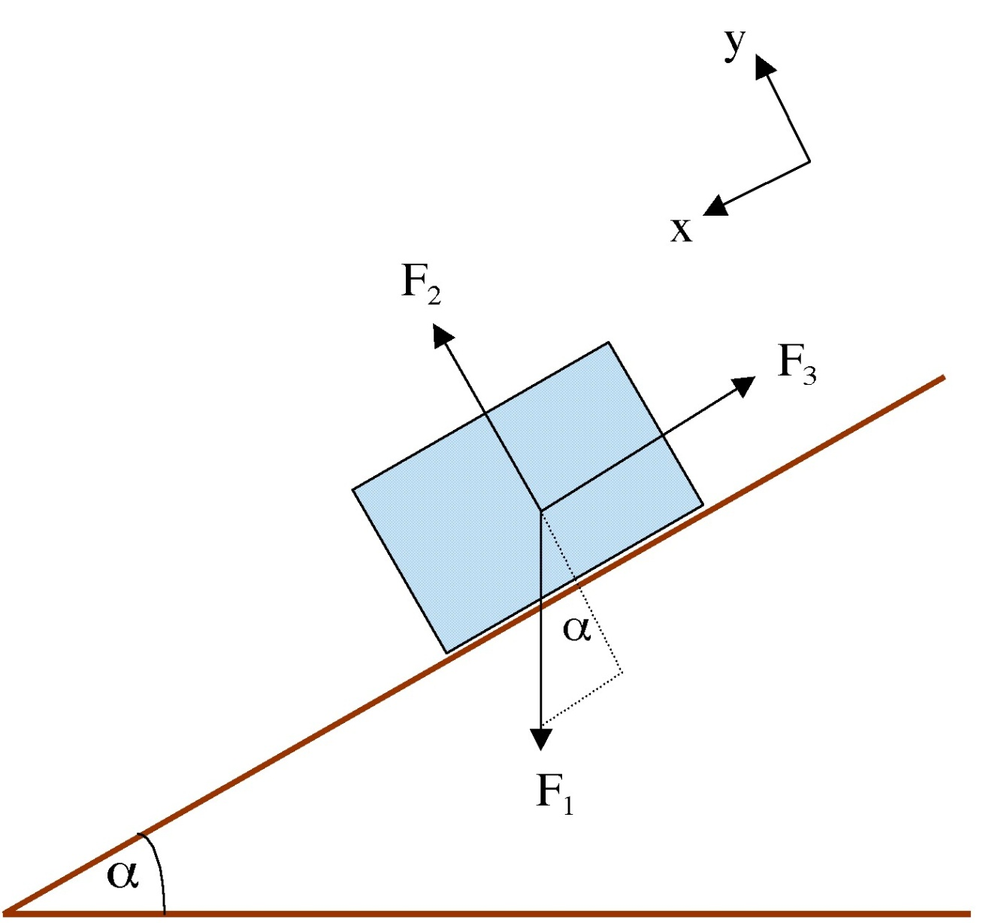
Free-body diagrams

Slide 25
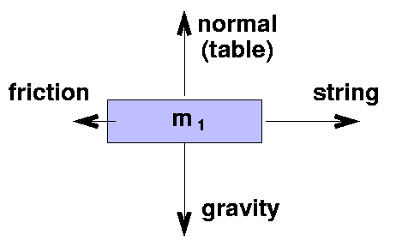
Free-body diagrams
Shows the magnitude and direction of all forces acting on a single body
The diagram shows the body only and the forces acting on it.

Slide 26
Examples
Mass hanging on a rope
T (tension in rope)
W (weight)

Slide 27
Examples
If a body touches another body there is a force of reaction or contact force. The force is perpendicular to the body exerting the force
Inclined slope
R (normal reaction force)
F (friction)
W (weight)

Slide 28
Examples
String over a pulley (stationary)
T (tension in rope)
T (tension in rope)
W₁
W₁

Slide 29
Examples
Ladder leaning against a wall
F
R
R
W
F

Slide 30
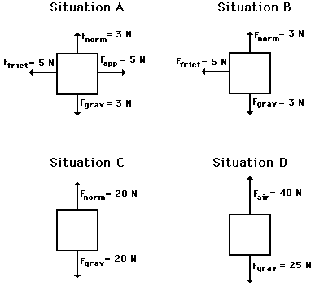
Free-body diagrams for four situations are shown below. For each situation, determine the net force acting upon the object.

Slide 31
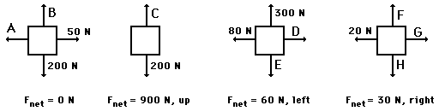
Free-body diagrams for four situations are shown below. The net force is known for each situation. However, the magnitudes of a few of the individual forces are not known. Analyze each situation individually and determine the magnitude of the unknown forces.

Slide 32
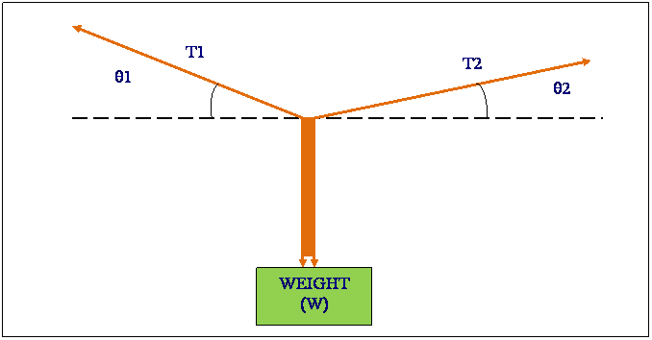
Resolving vectors into components

Slide 33
Resolving vectors into components
It is sometime useful to split vectors into perpendicular components

Slide 34
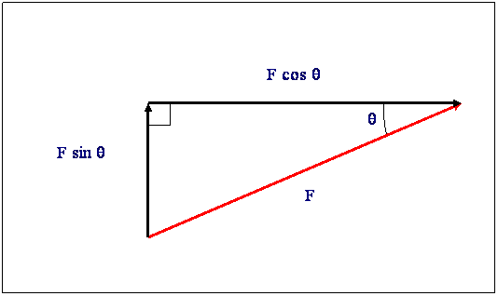
Resolving vectors into components

Slide 35
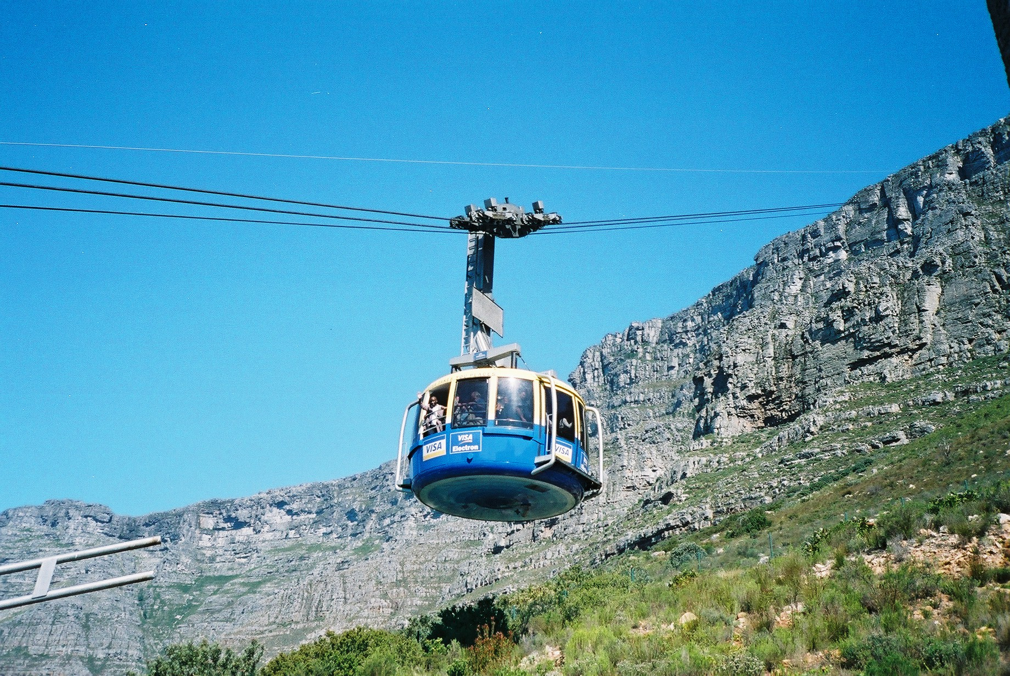
The cable car question - revisited

Slide 36
Tension in the cables?
T
10°
T
10 000 N

Slide 37
Vertically 10 000 = 2 X T X sin10°
T
10°
T
Cable Car
T X sin10°=Ty
T X sin10°
10 000 N

Slide 38
Vertically 10 000/2xsin10° = ?
T
10°
T
Cable Car
T X sin10°
T X sin10°
10 000 N

Slide 39
T = 28 800 N
T
10°
T
Cable Car
T X sin10°
T X sin10°
10 000 N

Slide 40
What happens as the angle deceases?
T = 10 000/2xsinθ
T
θ
T
10 000 N

Slide 41
Resolving Forces
Q. A force of 50N is applied to a block on a worktop at an angle of 30º to the horizontal.
What are the vertical and horizontal components of this force?

Slide 42
Answer
First we need to draw a free-body diagram
50N
30º

Slide 43
We can then resolve the force into the 2 components
Vertical = 50 sin 30º
50N
30º
Horizontal = 50 cos 30º

Slide 44
Therefore
  Vertical = 50 sin 30º = 25N
  Horizontal = 50 cos 30º = 43.3 = 43N

Slide 45
Determining the Resultant Force
Two forces act on a body P as shown in the diagram
Find the resultant force on the body.
50N
30º
30N

Slide 46
Solution
Resolve the forces into the vertical and horizontal componenets (where applicable)
50 sin 30º
50N
30º
30N
50 cos 30º

Slide 47
Add horizontal components and add vertical components.
50 sin 30º = 25N
50 cos 30º – 30N = 13.3N

Slide 48
Now combine these 2 components
25N
R
13.3N
R² = 25² + 13.3²
R = 28.3 = 28N

Slide 49
Review Quiz
Newton's 1st Law
Newton's 2nd Law

Slide 50
Newton's 3rd Law
For every action force, there is a reaction force that is equal in magnitude and opposite in direction.

Slide 51

Newton’s 3rd Law
How many objects are present?
How many forces are present?
How many forces act on each object?

Slide 52
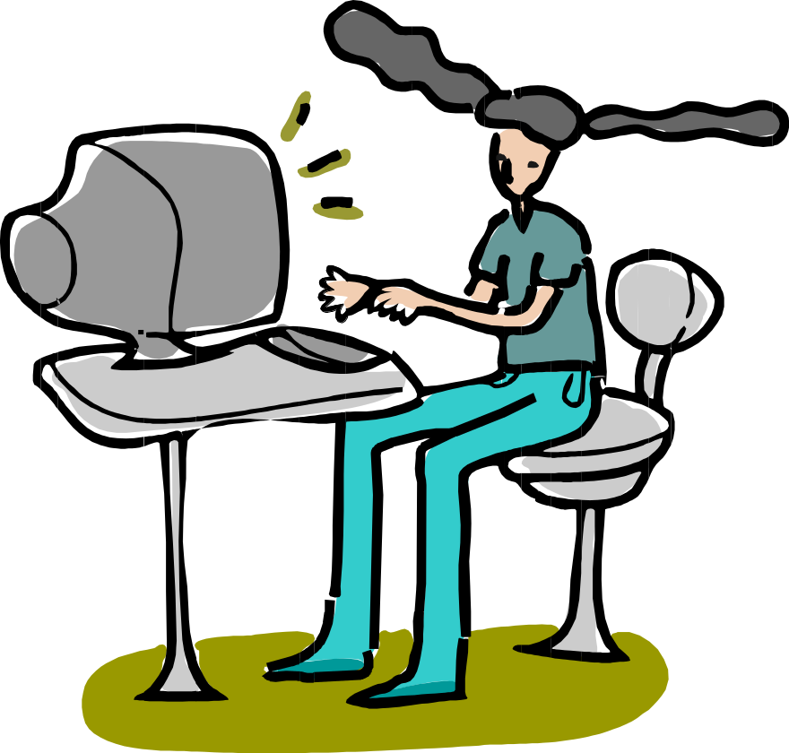
3rd Law
There are two forces resulting from this interaction - a force on the chair and a force on your body. These two forces are called action and reaction forces.

Slide 53

Newton’s 3rd Law in Nature
How do fishes swim?
Consider the propulsion of a fish through the water. A fish uses its fins to push water backwards
In turn, the water reacts by pushing the fish forwards, propelling the fish through the water.
The size of the force on the water equals the size of the force on the fish; the direction of the force on the water (backwards) is opposite the direction of the force on the fish (forwards).

Slide 54
How do birds fly?
Consider the flying motion of birds. A bird flies by use of its wings. The wings of a bird push air downwards. In turn, the air reacts by pushing the bird upwards.
The size of the force on the air equals the size of the force on the bird; the direction of the force on the air (downwards) is opposite the direction of the force on the bird (upwards).
Action-reaction force pairs make it possible for birds (even metal ones!) to fly.

Slide 55

3rd Law
Flying gracefully through the air, birds depend on Newton’s third law of motion. As the birds push down on the air with their wings, the air pushes their wings up and gives them lift.

Slide 56

Newton's 3rd Law
How do we launch rockets and space shuttles?
Reaction force to exhaust
F_{thrust}
The hot gases push against the inside tube of the rocket and escape out the bottom of the tube. As the gases move downward, the rocket moves in the opposite direction
F_{gravity}

Slide 57
Review Quiz
Newton's 3rd Law

