Slide 1
Mechanics
Topic 2.1 Kinematics

Slide 2
A reminder
Average speed = distance travelled
time taken
d
t
S
x

Slide 3
Distance against time graphs
position
time

Slide 4
No movement?
position
time

Slide 5
No movement
position
time

Slide 6
Constant speed?
position
time

Slide 7
Constant speed
position
time

Slide 8
Constant speed
position
The gradient of this graph gives the speed
time

Slide 9

Constant speed
How would the graph look different for a faster constant speed?
position
time

Slide 10
Constant speed
fast
position
time

Slide 11
Constant speed
fast
How would the graph look different for a slower constant speed?
position
time

Slide 12
Constant speed
fast
position
slow
time

Slide 13
Kinematic Concepts
Displacement
Is a change in position
It tells us not only the distance of the object from a particular reference point but also the direction from that reference point
It is a vector quantity
In many situations it is measured from the origin of a Cartesian co-ordinate system

Slide 14
Kinematic Concepts
Velocity
Is the rate of change of position
Is a measured speed in a given direction
It tells us not only the speed of the object but also the direction
It is a vector quantity

Slide 15
Average Velocity
Defined as the total displacement (s) of the object in the total time (t)
Velocity (v_{av}) = total displacement (s) total time (t)
v_{av} = Δs Δt
Where Δ indicates a small change in the value

Slide 16
Instantaneous Velocity
Is the velocity at any one moment in time
v = Δs Δt
Where Δt is tending towards zero (think tangent)

Slide 17
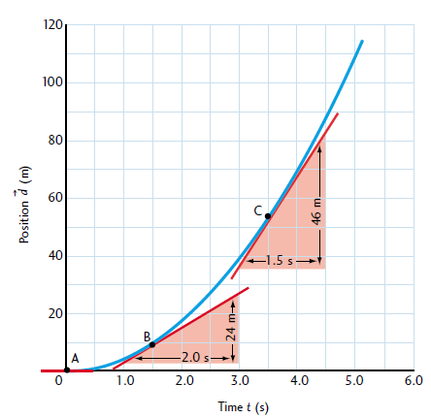
Instantaneous Velocity

Slide 18
Getting faster? (accelerating)
position
time

Slide 19
Getting faster (accelerating)
position
time

Slide 20
Examples
position
time

Slide 21
A car accelerating from stop and then hitting a wall
position
time

Slide 22
A car accelerating from stop and then hitting a wall
position
time

Slide 23
Velocity against time graphs
velocity
time

Slide 24
No movement?
velocity
time

Slide 25
No movement
velocity
time

Slide 26
Constant speed?
velocity
time

Slide 27
Constant speed
velocity
time

Slide 28
Constant speed
How would the graph look different for a faster constant speed?
velocity
time

Slide 29
Constant speed
velocity
fast
time

Slide 30
Constant speed
How would the graph look different for a slower constant speed?
velocity
fast
time

Slide 31
Constant speed
velocity
fast
slow
time

Slide 32
Getting faster? (accelerating)
velocity
time

Slide 33
Getting faster? (accelerating)
velocity
Constant acceleration
time

Slide 34
Getting faster? (accelerating)
velocity
The gradient of this graph gives the acceleration
time

Slide 35
Getting faster? (accelerating)
v
The gradient of this graph gives the acceleration
velocity
a = v – u
t
(v= final speed, u = initial speed)
u
time

Slide 36
Getting faster? (accelerating)
velocity
The area under the graph gives the distance travelled
time

Slide 37
Example:
velocity
time

Slide 38
A dog falling from a tall building (no air resistance)
velocity
time

Slide 39
A dog falling from a tall building (no air resistance)
velocity
time

Slide 40
A dog falling from a tall building (no air resistance)
velocity
Area = height of building
time

Slide 41
Kinematic Concepts
Acceleration
Is the rate of change of velocity in a given direction
a = Δv / Δt (where Δv = v – u)
It is a vector quantity
If the acceleration of an object is positive then we understand its rate of change of velocity to be positive and it could mean that its speed is increasing
    Do not think of acceleration as a ´slowing up´or a ´getting faster´.

Slide 42
Graphical Representation of Motion
These come in 3 forms
1. Position-time graphs
2. Velocity-time graphs
3. Acceleration-time graphs

Slide 43
Gradients of Graphs
Gradient of a Position-time graph is the velocity (instantaneous or average?)
Gradient of a Velocity-time graph is the acceleration (instantaneous or average?)

Slide 44
Areas Under Graphs
Area under a Velocity-time graph is the displacement
Area under a Acceleration-time graph is the velocity
Areas can be calculated by the addition of geometric shapes

Slide 45
“Calculus” for Graphs
Position – Time
Velocity – Time
Acceleration – Time
Gradients
Areas

Slide 46
Be careful!
velocity
position
time
time

Slide 47
No movement
velocity
position
time
time

Slide 48
Constant speed
velocity
position
time
Area = distance travelled
time

Slide 49
Constant acceleration
velocity
Gradient = acceleration
a = (v-u)/t
position
time
Area = distance travelled
time

